Slide 1
Diagnostic options for netlinx and nx series controllers
Stephen steiner

Slide 2
overview
Netlinx Studio
Diagnostics
Notifications
Helpful options located in Preferences
Settings..Preferences..Diagnostics..Read xx line(s) from the buffer every ¼ second
Settings..Preferences..Diagnostics..Notification View ASCII and HEX values
Control a Device
Emulate a Device
Programming
SEND_STRING 0 and the alternate AMX LOG
Why we should be using the alternate
Log levels
Setting
Getting
TELNET
USB Logging
Turning on
Turning off
High level interpretation
MSG ON
Same levels of debug as AMX LOG
ERROR
WARNING
INFO
DEBUG
Alternatives to writing files constantly, using non-volatile or persistent variables

Slide 3
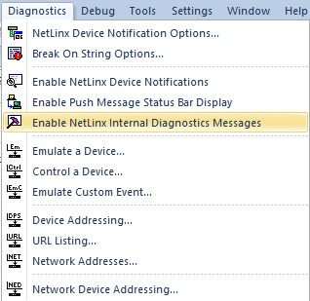
Netlinx studio - DIAGNOSTICS
Used to see system and program generated messages
IP_CLIENT or IP_SERVER Online, Offline, OnError
AMX_LOG messages and SEND_STRING 0
FILE operation errors
Timeline errors etc.
Diagnostics respects the debug level set from code which we will explore later
Enable Under Diagnostics, Notification Options, or status bar

Slide 4
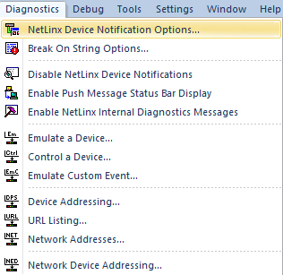
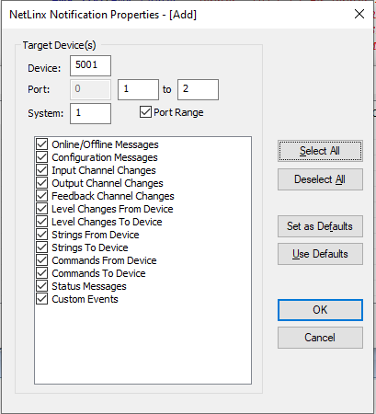
Netlinx studio - notifications
Used to see Strings, Commands, Channels, Levels, and Custom Events from devices.
Edit what you see from Netlinx Device Notification Options
You can use PORT 0 to see information from all ports on a device or enter a port range.
Must use the real system number for your system.
*You are not able to see information to and from IP_CLIENT connections
Choose types of notifications to show by checking/unchecking boxes next to the message type.
Enable Under Diagnostics, Notification Options, or status bar

Slide 5
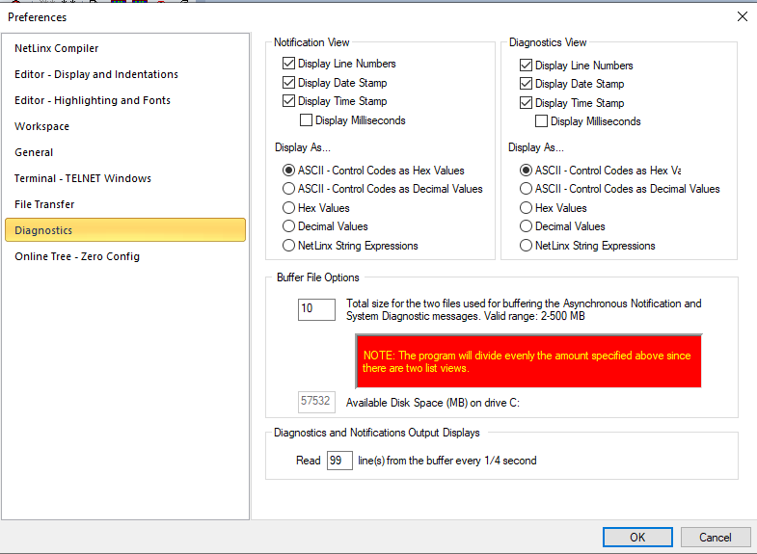
Netlinx studio - preferences
Diagnostics and Notifications Output Displays
I change it to 99. This keeps Diagnostics or Notifications from building up a bunch of messages and then jumping to the bottom of those messages. It lets you see messages as come in.
Display As..
You are able to change how messages are displayed in Diagnostics and Notifications. If RS232 strings are coming in or being sent out with a mix of printable and non-printable characters, you can choose to display the output as all HEX which might make it easier to read.

Slide 6
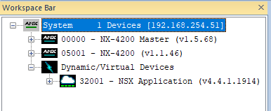
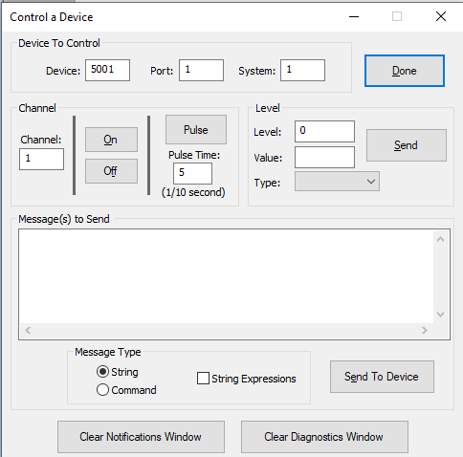
Netlinx studio – control a device
System number
Needs to be your real system number, 0 can’t be used. If you don’t know your system number, refer to the online tree.
String Expressions
If the box is unchecked, control a device will only send out ASCII.
Checking the box requires the use of double and single quotes, just like Netlinx code.
Feedback in Notifications
You will not see a String To in Notifications when using Control a Device, only a String From if the device replies.

Slide 7
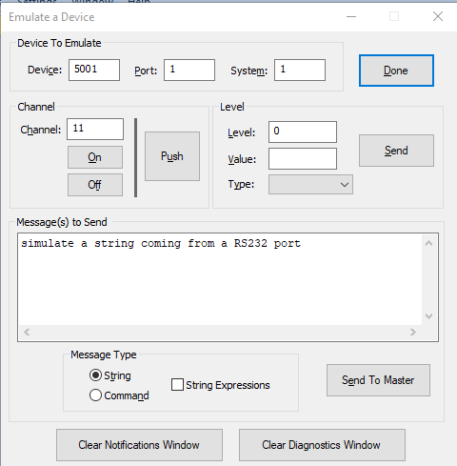
Netlinx studio – emulate a device
Same rules as Control a Device for system number, can’t be 0
Same use of String Expressions
Used to simulate functions in the processor, to make the processor think something has happened when it really hasn’t.

Slide 8
AMX_LOG, alternate to send_string 0
Why is SEND_STRING 0 not ideal to use anymore?
We have been made aware that every SEND_STRING 0 gets written to the audit log that resides on the micro-SD card. Therefore, every SEND_STRING 0 causes a write to the disk and could possibly shorten the life of the micro-SD card. AMX_LOG does not get written to the audit log and does not cause a write to disk.
AMX_LOG(CONSTANT INTEGER LEVEL, CHAR MESSAGE[])
The four valid log levels are:
AMX_ERROR = 1
Lowest level, will show up regardless of logging level set from code.
Will act just like a SEND_STRING 0
AMX_WARNING = 2
AMX_INFO = 3
AMX_DEBUG = 4
Example: (These are equivalent and will act the same.)
SEND_STRING 0, "'ERROR: BUTTON ',ITOA(BUTTON.INPUT.CHANNEL),
' WAS PRESSED ON DEVICE ',ITOA(BUTTON.INPUT.DEVICE.NUMBER),
':',ITOA(BUTTON.INPUT.DEVICE.PORT)“
AMX_LOG(AMX_ERROR,"'ERROR: BUTTON ',ITOA(BUTTON.INPUT.CHANNEL),
' WAS PRESSED ON DEVICE ',ITOA(BUTTON.INPUT.DEVICE.NUMBER),
':',ITOA(BUTTON.INPUT.DEVICE.PORT)")
You get one more character with AMX_LOG, it truncates to a length of 255 instead of send_string 0 that truncates to 254!

Slide 9
Set_log_level & Get_log_level
Set the logging level for code. This overrides what you will see in telnet, diagnositics, and usb logging. Please be careful setting the logging level from code since it may have the unintended consequence of keeping you from seeing messages you might need to see.
SET_LOG_LEVEL(CONSTANT INTEGER LEVEL)
The four valid log levels are:
INTEGER AMX_ERROR = 1
INTEGER AMX_WARNING = 2
INTEGER AMX_INFO = 3
INTEGER AMX_DEBUG = 4
I would recommend never using this command. Know it exists, but in code, only specify AMX_ERROR when using AMX_LOG so the messages in your code will show up regardless of the level. This will act identical to SEND_STRING 0.
INTEGER GET_LOG_LEVEL()
Retrieves the current log level for the program.
Where the returned value will be one of the for log levels:
INTEGER AMX_ERROR = 1
INTEGER AMX_WARNING = 2
INTEGER AMX_INFO = 3
INTEGER AMX_DEBUG = 4

Slide 10
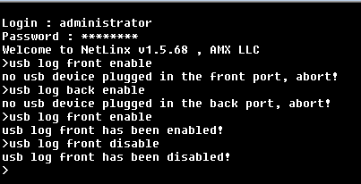
telnet – usb logging
Commands: (not case sensitive)
USB LOG FRONT ENABLE
USB LOG FRONT DISABLE
USB LOG BACK ENABLE
USB LOG BACK DISABLE
Will receive an error message if the processor does not detect USB media plugged in.
*Disable logging before removing the USB media
If the processor is unresponsive to telnet or SSH, reboot the processor, disable logging, then remove the USB media
USB stick must be formatted Windows FAT32
Same as Diagnostics, USB will respect debug levels set from code so be very careful with setting the debug levels.
Something I like to look for is the phrase: LoadConfiguration Complete
This is the first message we receive from the processor in a USB log to say it is starting up. It is easy to count how many times a processor has rebooted, by counting these messages. You can also look right above this message for the last thing the processor said before rebooting.

Slide 11
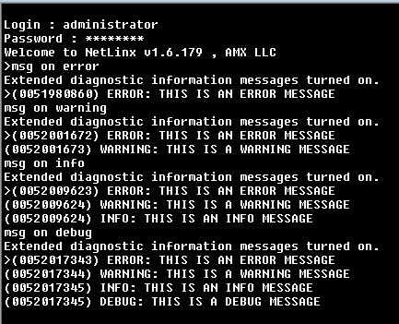
telnet – msg on
You are able to filter the log messages in telnet without changing the logging level from code.
Type “msg on” and then the logging level you wish to see.
Just typing “msg on” puts the level at “warning”
If you want to see all messages, always type “msg on debug”
Set the logging level for code. This overrides what you will see in telnet, diagnositics, and usb logging. Please be careful setting the logging level from code since it may have the unintended consequence of keeping you from seeing messages you might need to see.

Slide 12
Alternative to writing files constantly for logging
Writing log messages to disk has always been a popular way of storing information to look at in the future. We want to get away from this methodology because of the heavy writing to the micro-SD card. The goal should be to minimize writing to the micro-SD card to prolong its life.
The way I would recommend storing data without effecting the micro-SD card is in a PERSISTENT variable.
Persistent variables are not stored on the micro-SD card, they are stored in Nonvolatile RAM. Their contents are preserved through a power cycle or code load. They will not survive the backup battery being depleted or removed.
A brief summary
Determine a maximum size for your log message. Let’s say 64 characters.
Determine a maximum size for your persistent variable. Let’s say 10000 so your CHAR variable would look like cLOG_MESSAGES[10000][64]
This gives you a max number of messages, 10000/64 = 156 assuming all were 64 bytes in length but they won’t be so you’ll have a lot more space.
When the persistent variable is getting close to being full based off of length, you would write the contents of your persistent variable to a file and then clear the persistent variable and start the process over again.
This should help minimize file writing to the micro-SD card and prolong its life.
I can provide a code example upon request

Slide 13
Questions?
Questions?

